Slide 1
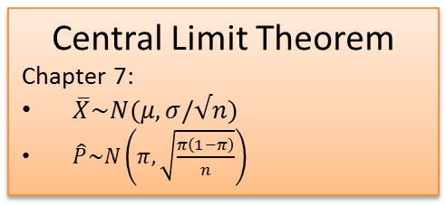
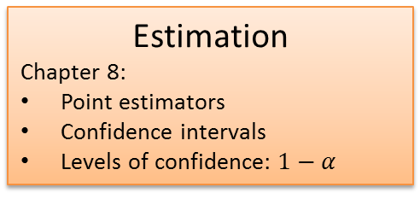
Econ 205 - Roadmap
Focus Midterm 1
Focus Midterm 2
Focus Final
Intro
Chapter 1:
Population vs. sample
Parameters vs. statistics
Discrete Distribution
Chapter 5:
Random variable
E[X], V[X] & Laws of expectation
Hypothesis Testing
Chapter 9:
Testing parameters: mu and pi
Left tailed, right tailed, two-tailed
Rejection regions approach
P-values
Levels of significance: *, **, ***
Type I and Type II errors
Graphs
Chapter 2:
Bar/Pie charts
Histogram: Data Analysis Toolpack!
Continuous Distributions
Chapter 6:
Density functions
Uniform distribution
Normal distribution: = norm.s.dist
T-distribution: = t.dist
Two Sample Tests
Chapter 10:
Compare mean across two populations
T-test
Descriptive Stats
Chapter 3:
Central tendency
Variability
Relative standing
2 variable stats
Central Limit Theorem
Chapter 7:
$\overline{X}\sim N(μ,σ/√n)$
$\hat{P}\sim N\left(π,\sqrt{\frac{π\left(1−π\right)}{n}}\right)$
Linear Regression
Chapters 13-14:
Least squares lines: scatterplot
Data analysis Toolpack
Multivariate regression
Dummy variables: 0/1
Regression Diagnostics
Basic Probability
Chapter 4:
Marginal prob.
Conditional prob.
Laws of prob.
Estimation
Chapter 8:
Point estimators
Confidence intervals
Levels of confidence: $1−α$

